Slide 1

What Is PDS4?
4-8 November 2024, ESAC, Spain

Slide 2
Contents
Who/What are PDS?
PDS/PSA Data Organisation
Bundles, collections and products
Logical vs physical structure
Data organisation in the PSA
The PDS4 Viewer

Slide 3
Who/What are PDS?

Slide 4
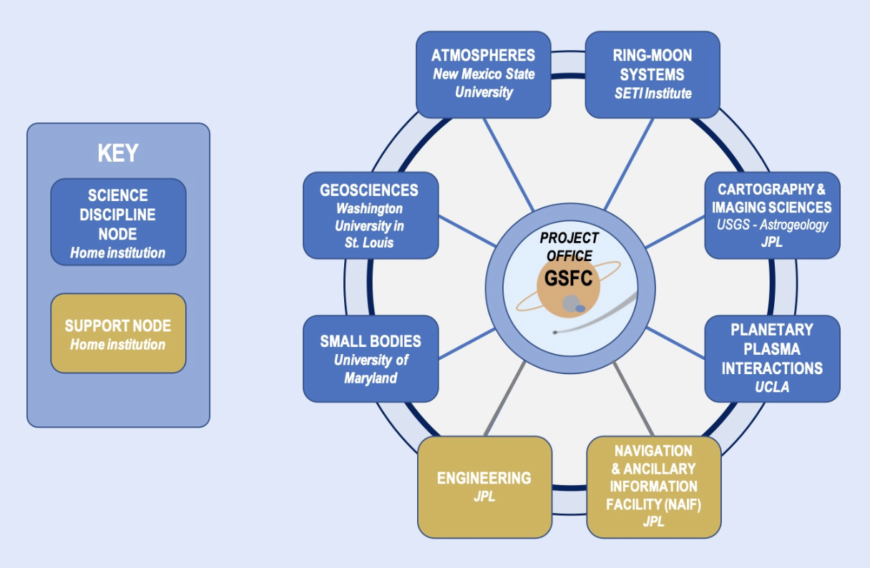
Who Is PDS?
The PDS is a federation of nine teams geographically distributed around the U.S.
Six are science discipline nodes, focusing on Atmospheres, Geosciences, Cartography and Imaging Sciences, Planetary Plasma Interactions, Ring-Moon Systems, and Small Bodies.
There are two support nodes: the Engineering Node, and the Navigation and Ancillary Information Node.
The ninth team is the project management group, which includes a project scientist function.

Slide 5
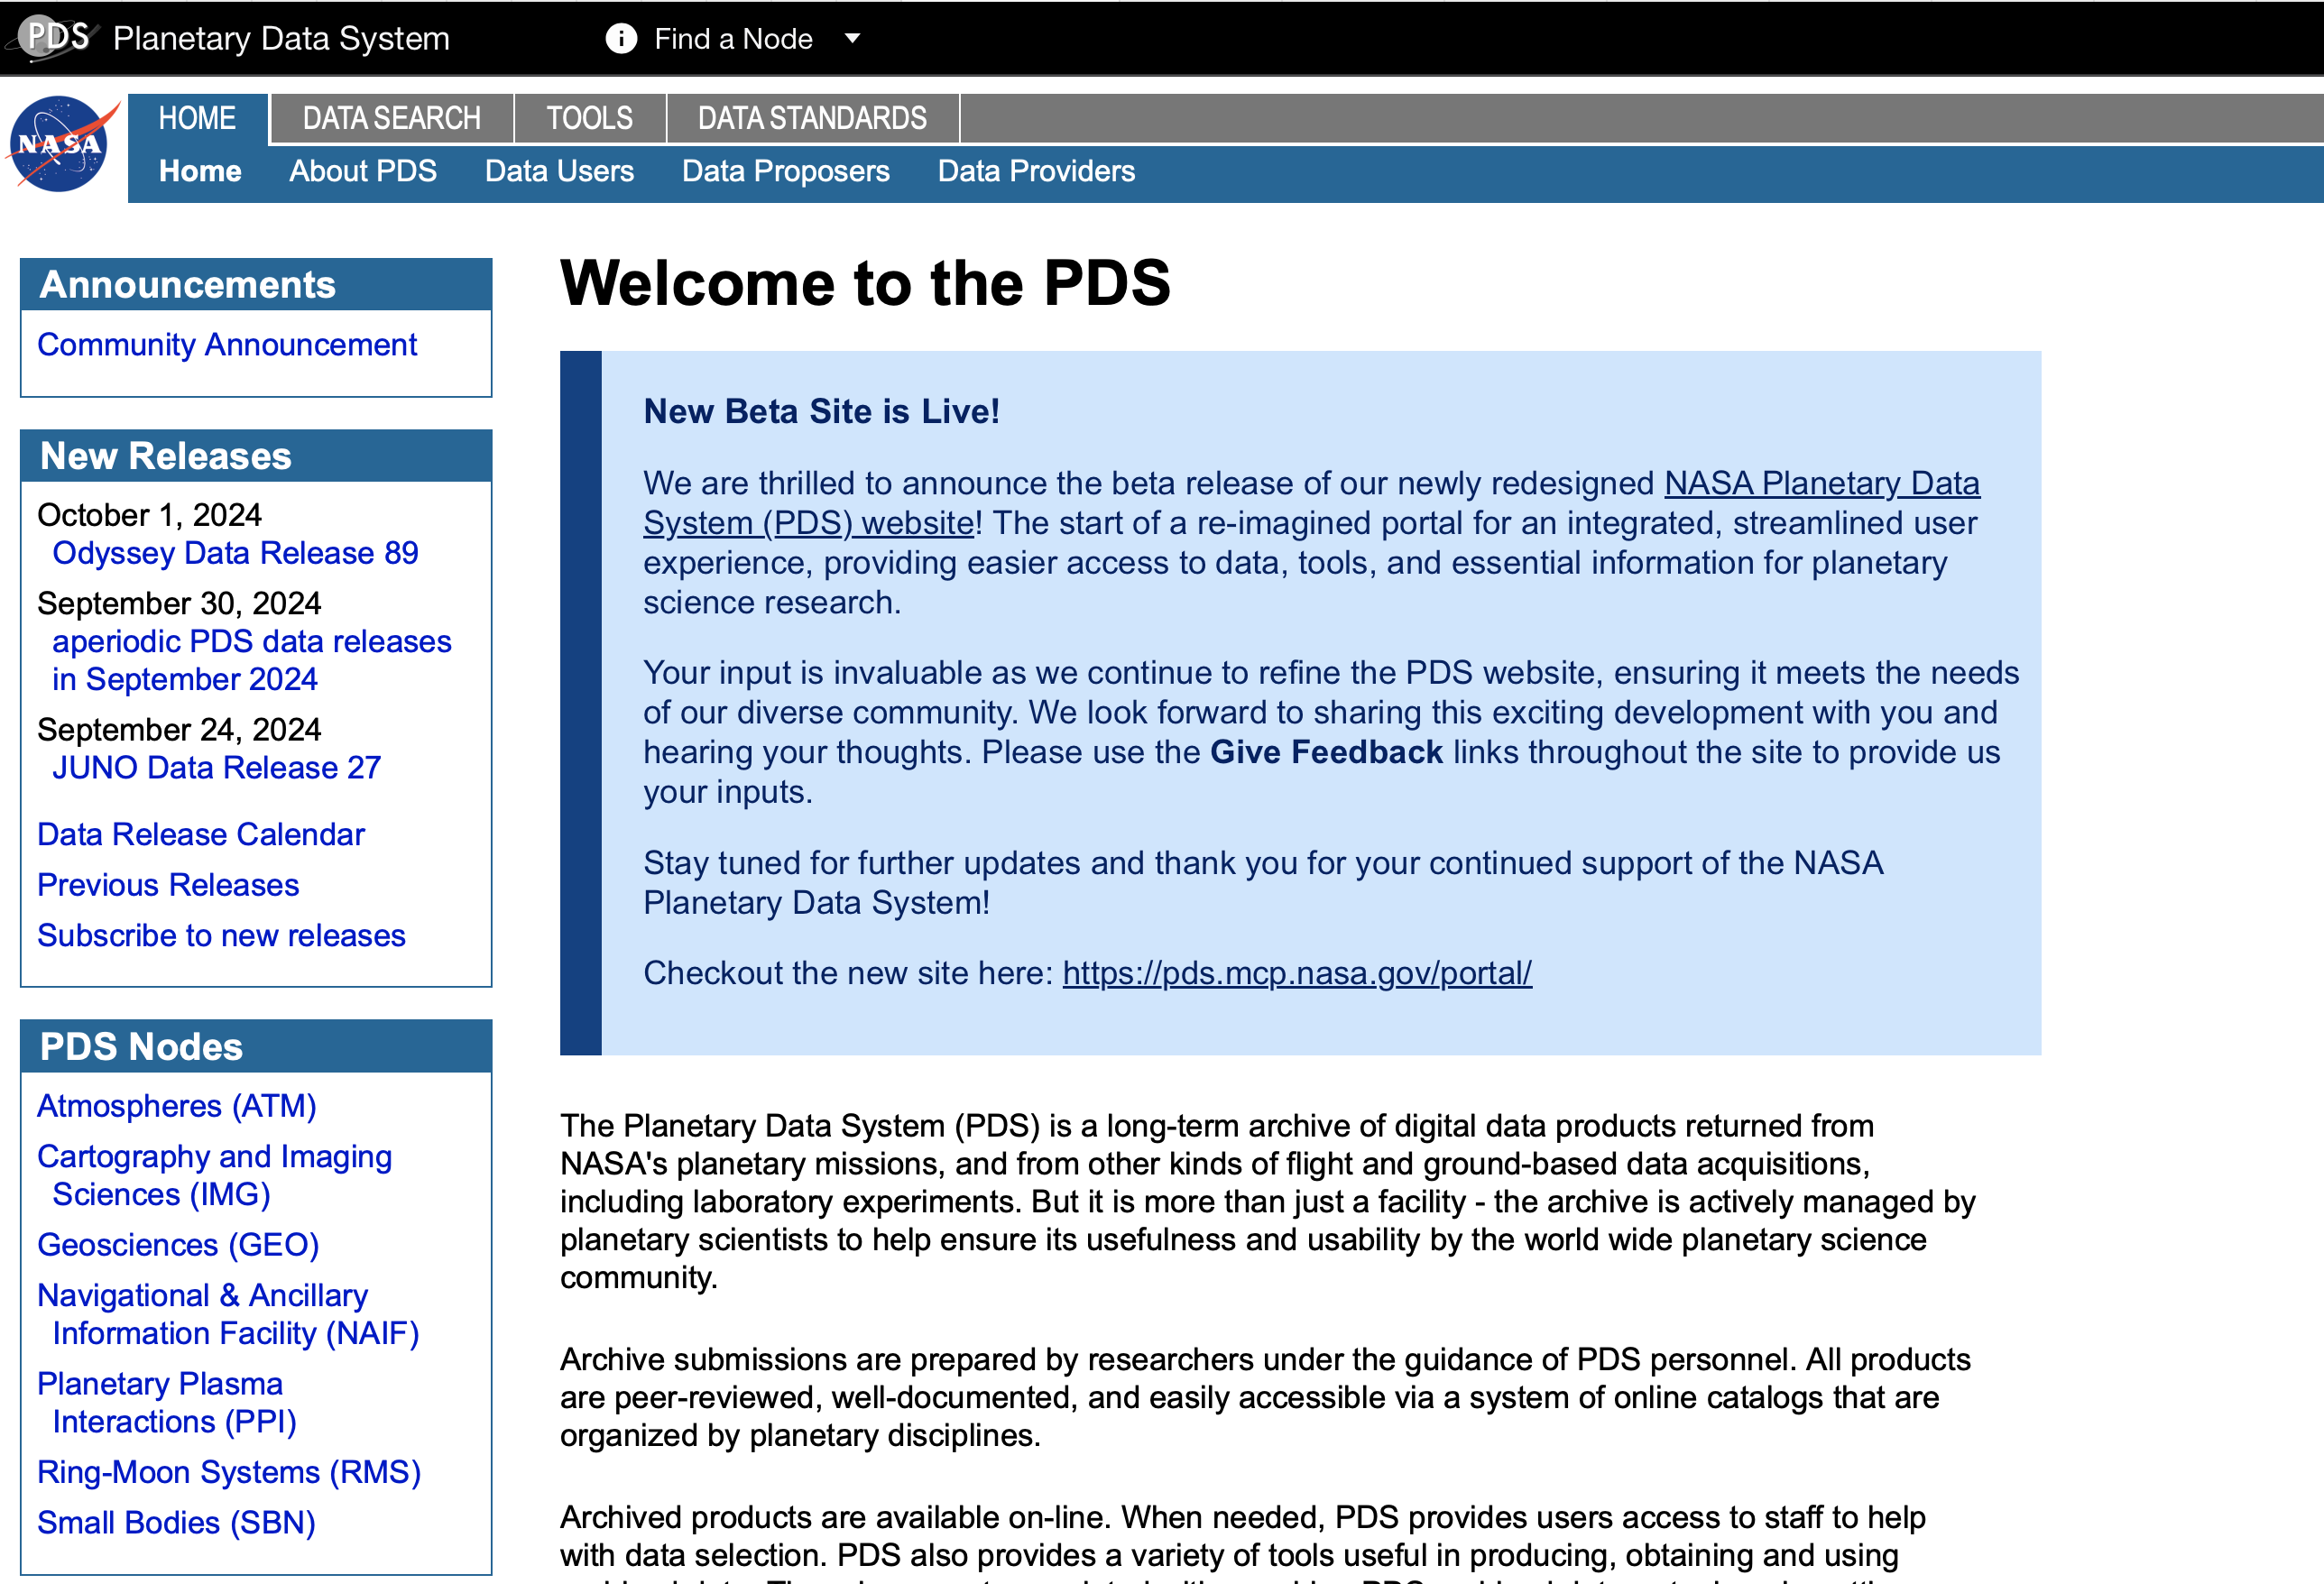
PDS Home Page
pds.nasa.gov

Slide 6
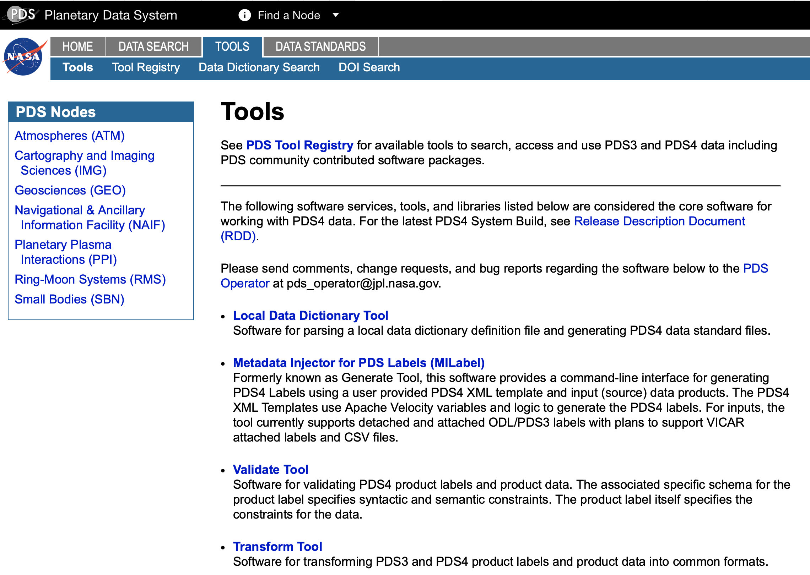

Slide 7
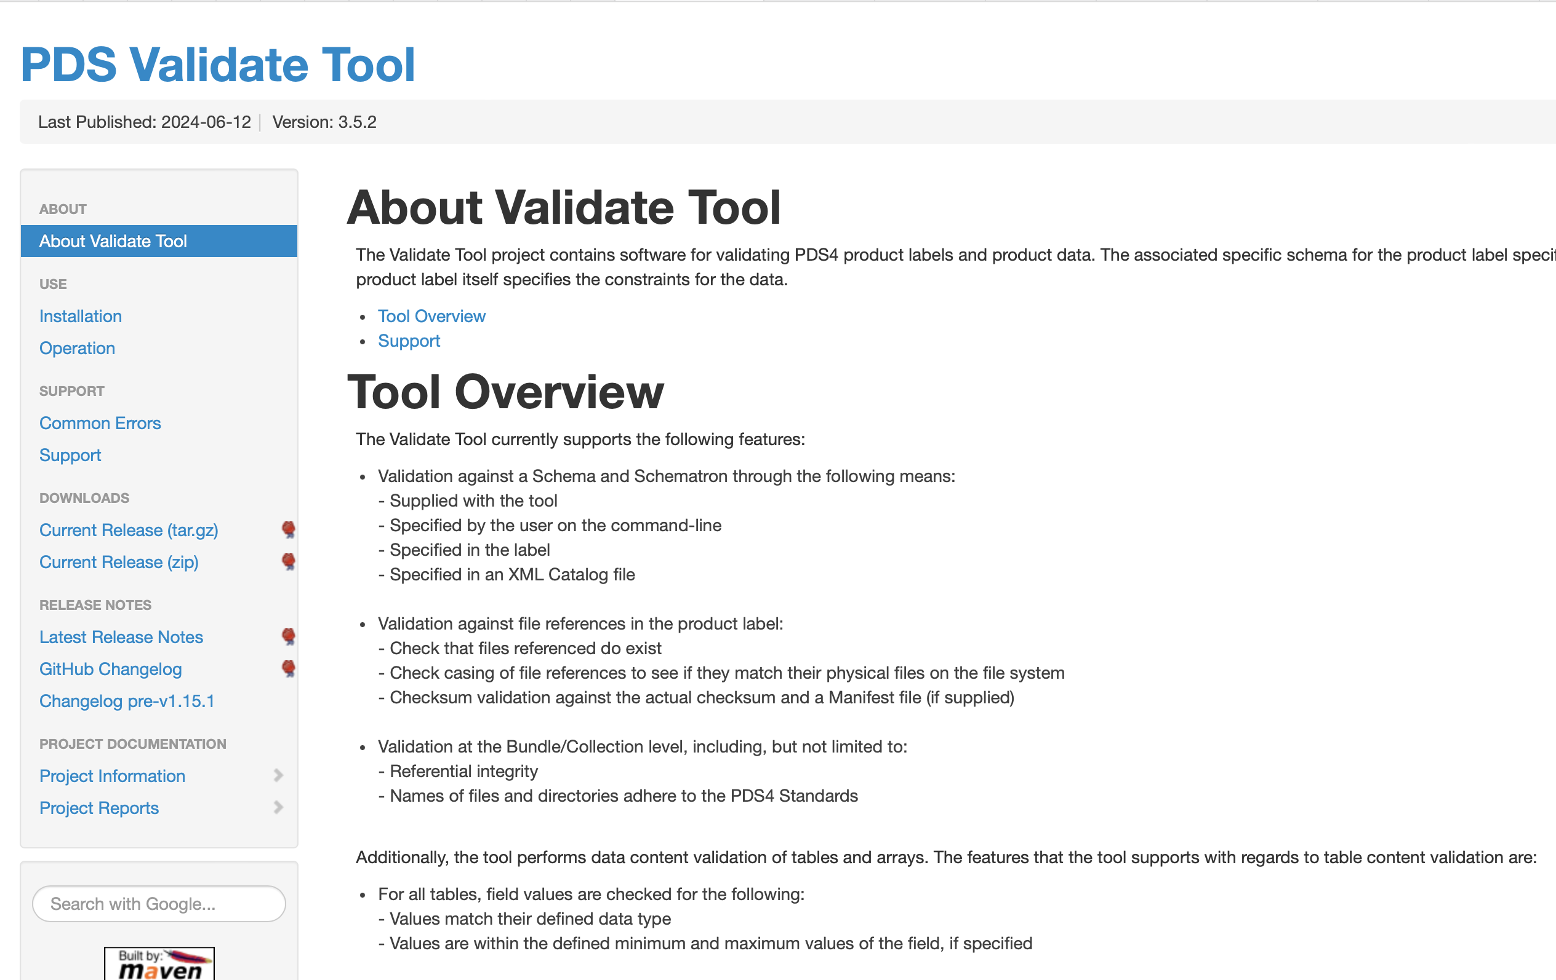
PDS4 Tool Download

Slide 8
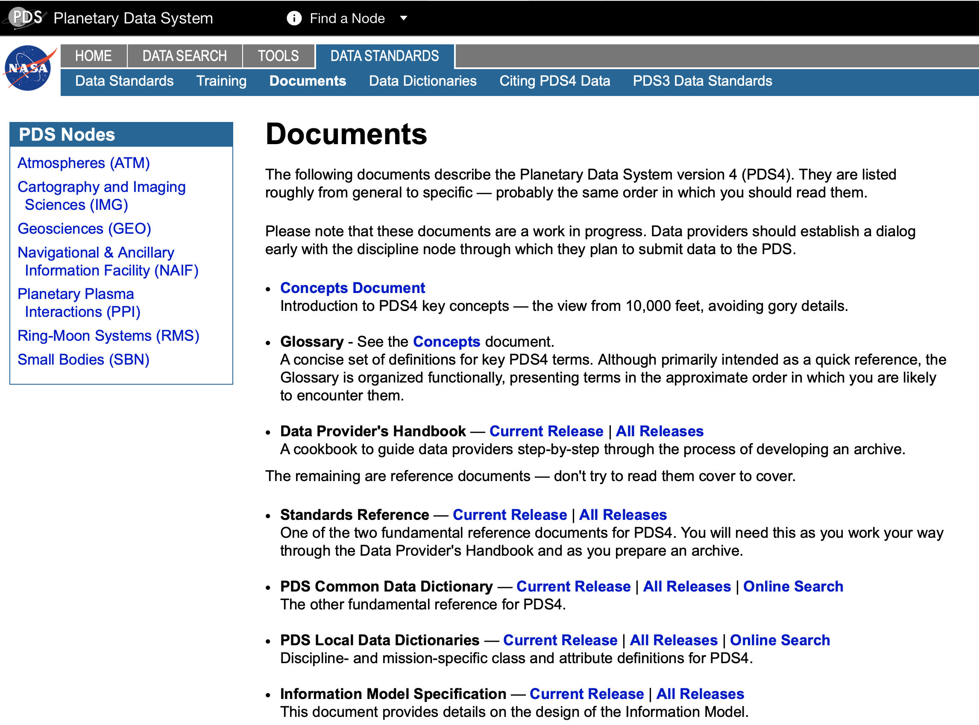

Slide 9
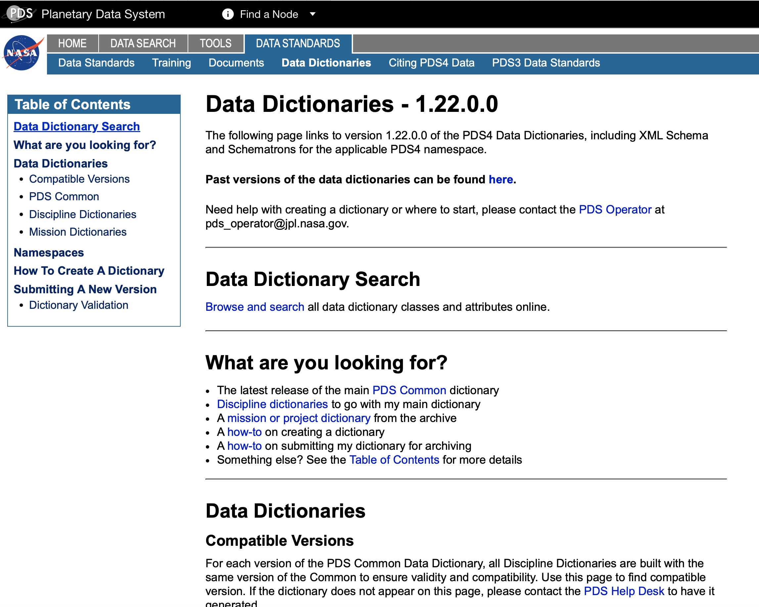

Slide 10
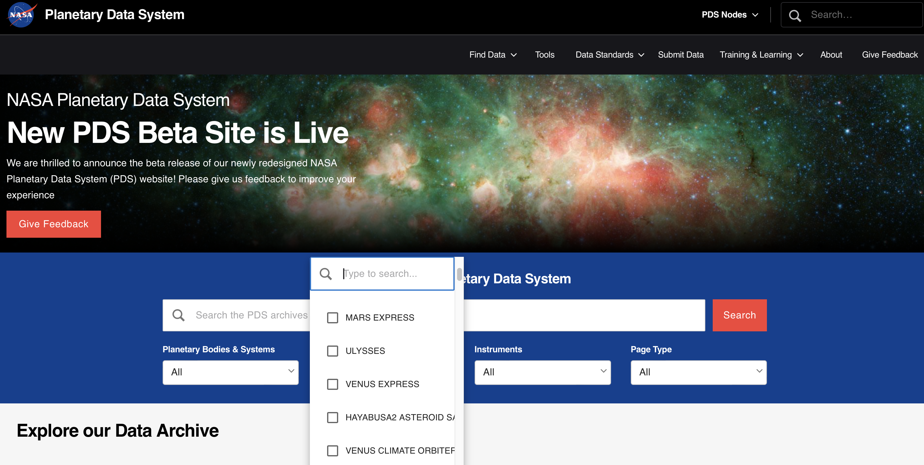
PDS New Landing Page

Slide 11
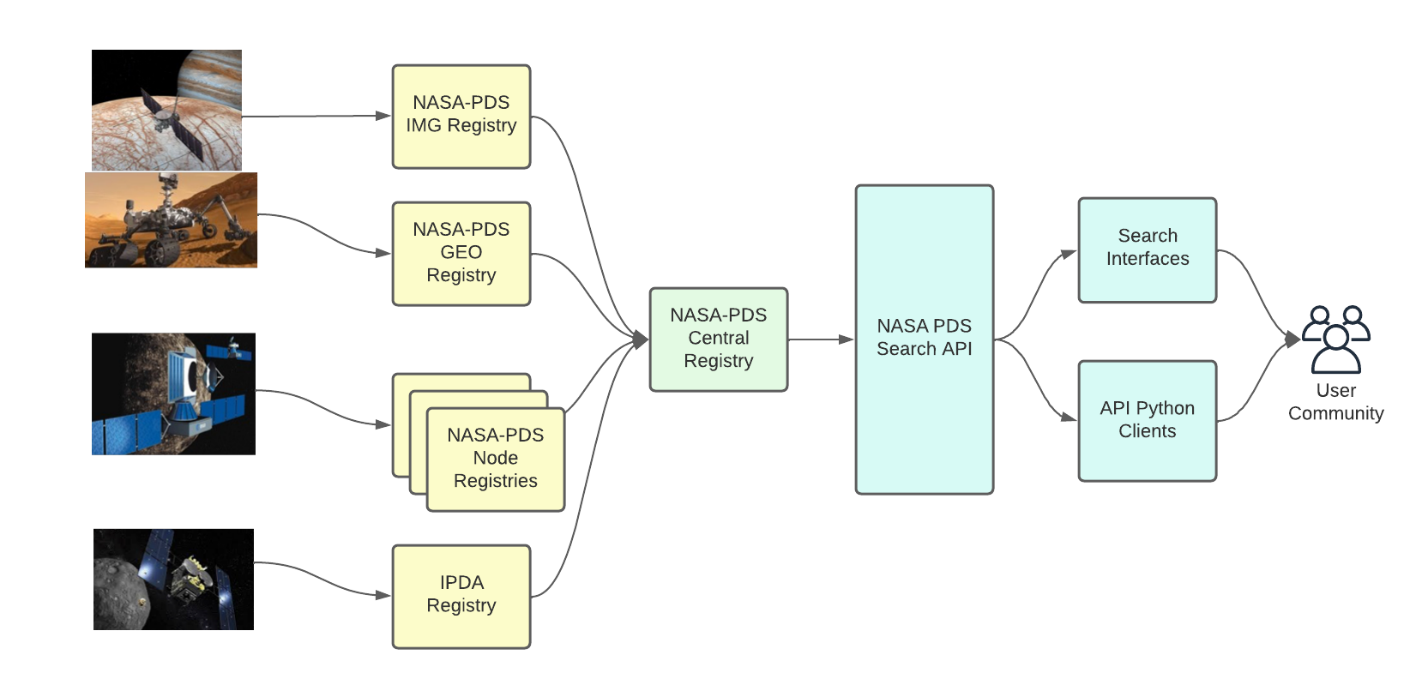
Harvest

Slide 12
PDS/PSA Data Structures

Slide 13
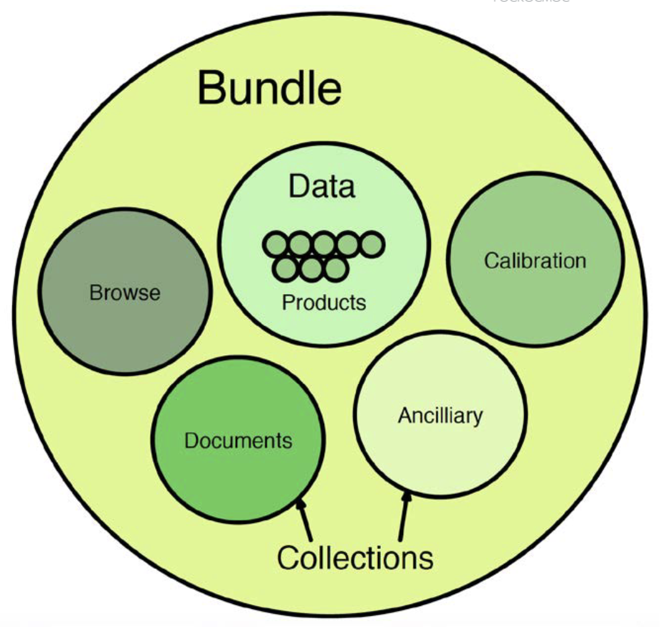
PDS4 Data Structures
Everything in a PDS4 archive is either a bundle, collection or product.
There are no restrictions on what goes into a bundle, it could be…
dataset,
instrument,
data type etc
In the PSA a bundle is generally formed from all data from one instrument.
Collections are then groups of all data forming one purpose.

Slide 14
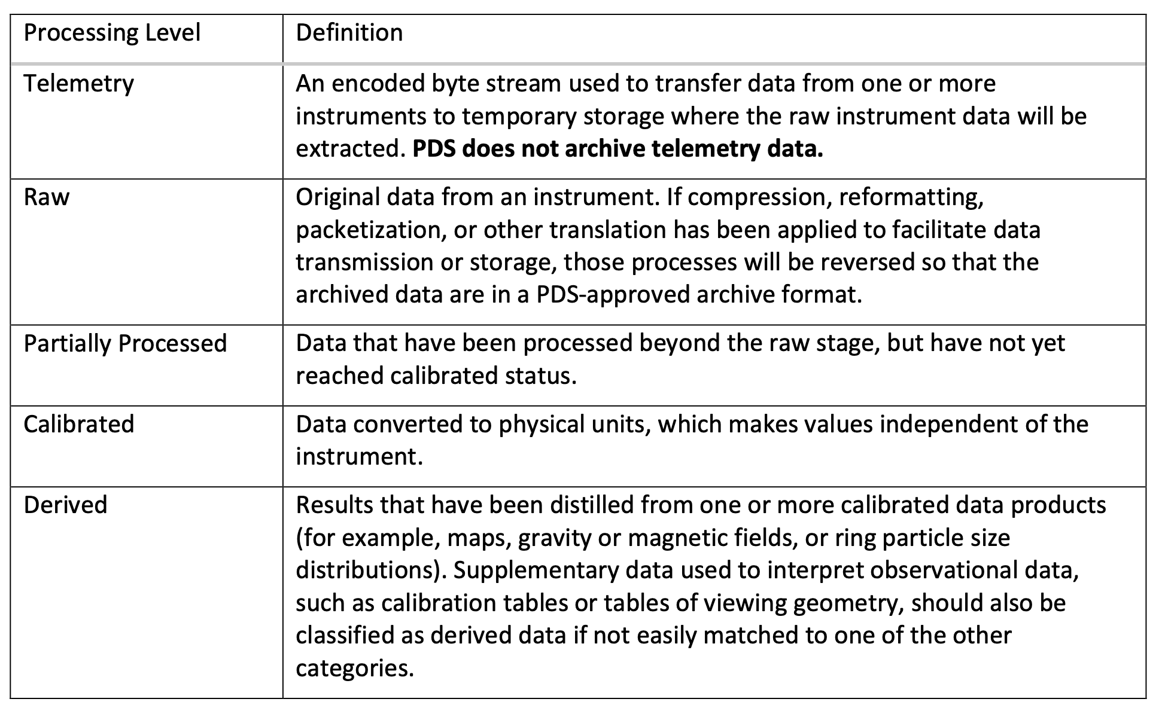
Data Processing Levels
Data Providers Handbook table 2-1

Slide 15
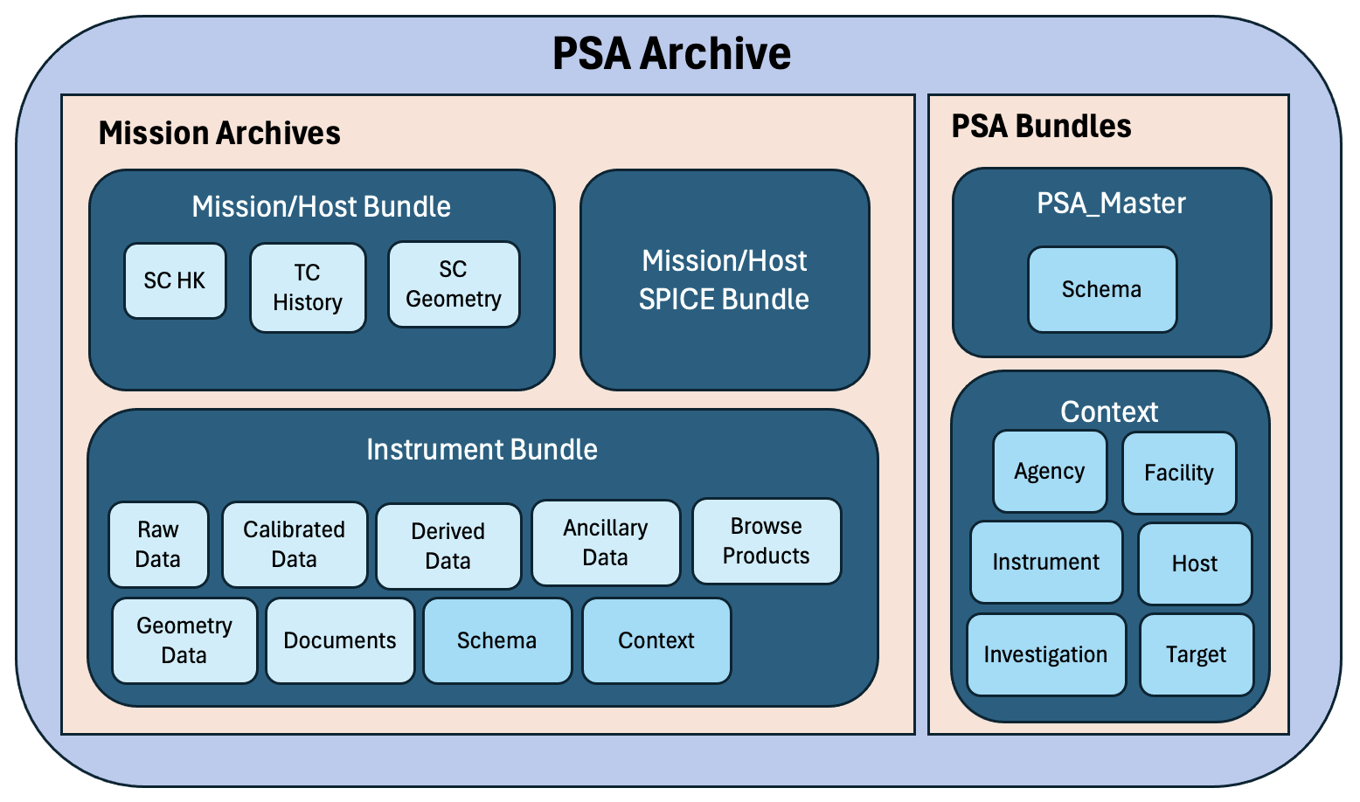
PSA Data Structures

Slide 16
Logical vs Physical
A bundle/collection/product is a logical entity and must have an appropriate label
For FTP and download a physical structure is required, and most archives including the PSA follow the logical structure
Just using bundle/collection/product is not sufficient for large bundles which comprise the PSA so on download lower level directories are used.
This physical structure is not mapped into the data products, but the logical structure is

Slide 17
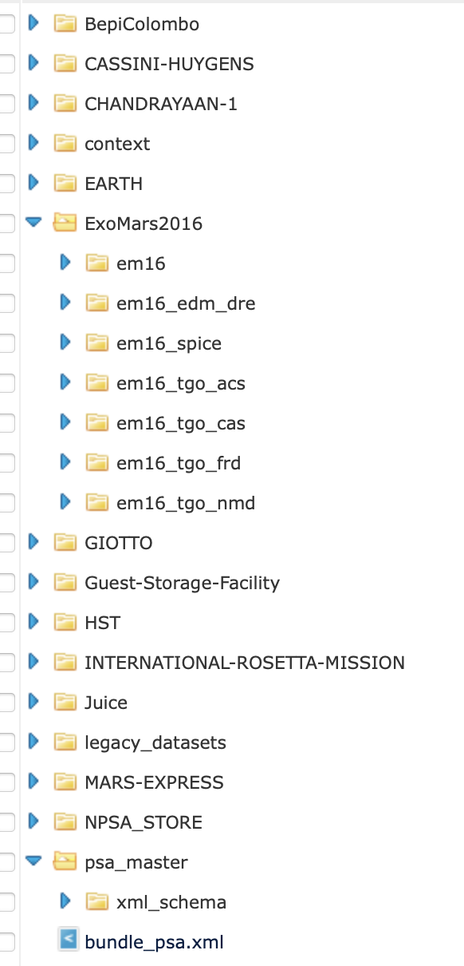
PSA Data Structures
Top level of the PSA FTP psaftp.esac.esa.int
Not everything here is a bundle:
The ExoMars2016 area is expanded to show the bundles for that mission.
Also the psa_master bundle is expanded to show the schema collection

Slide 18
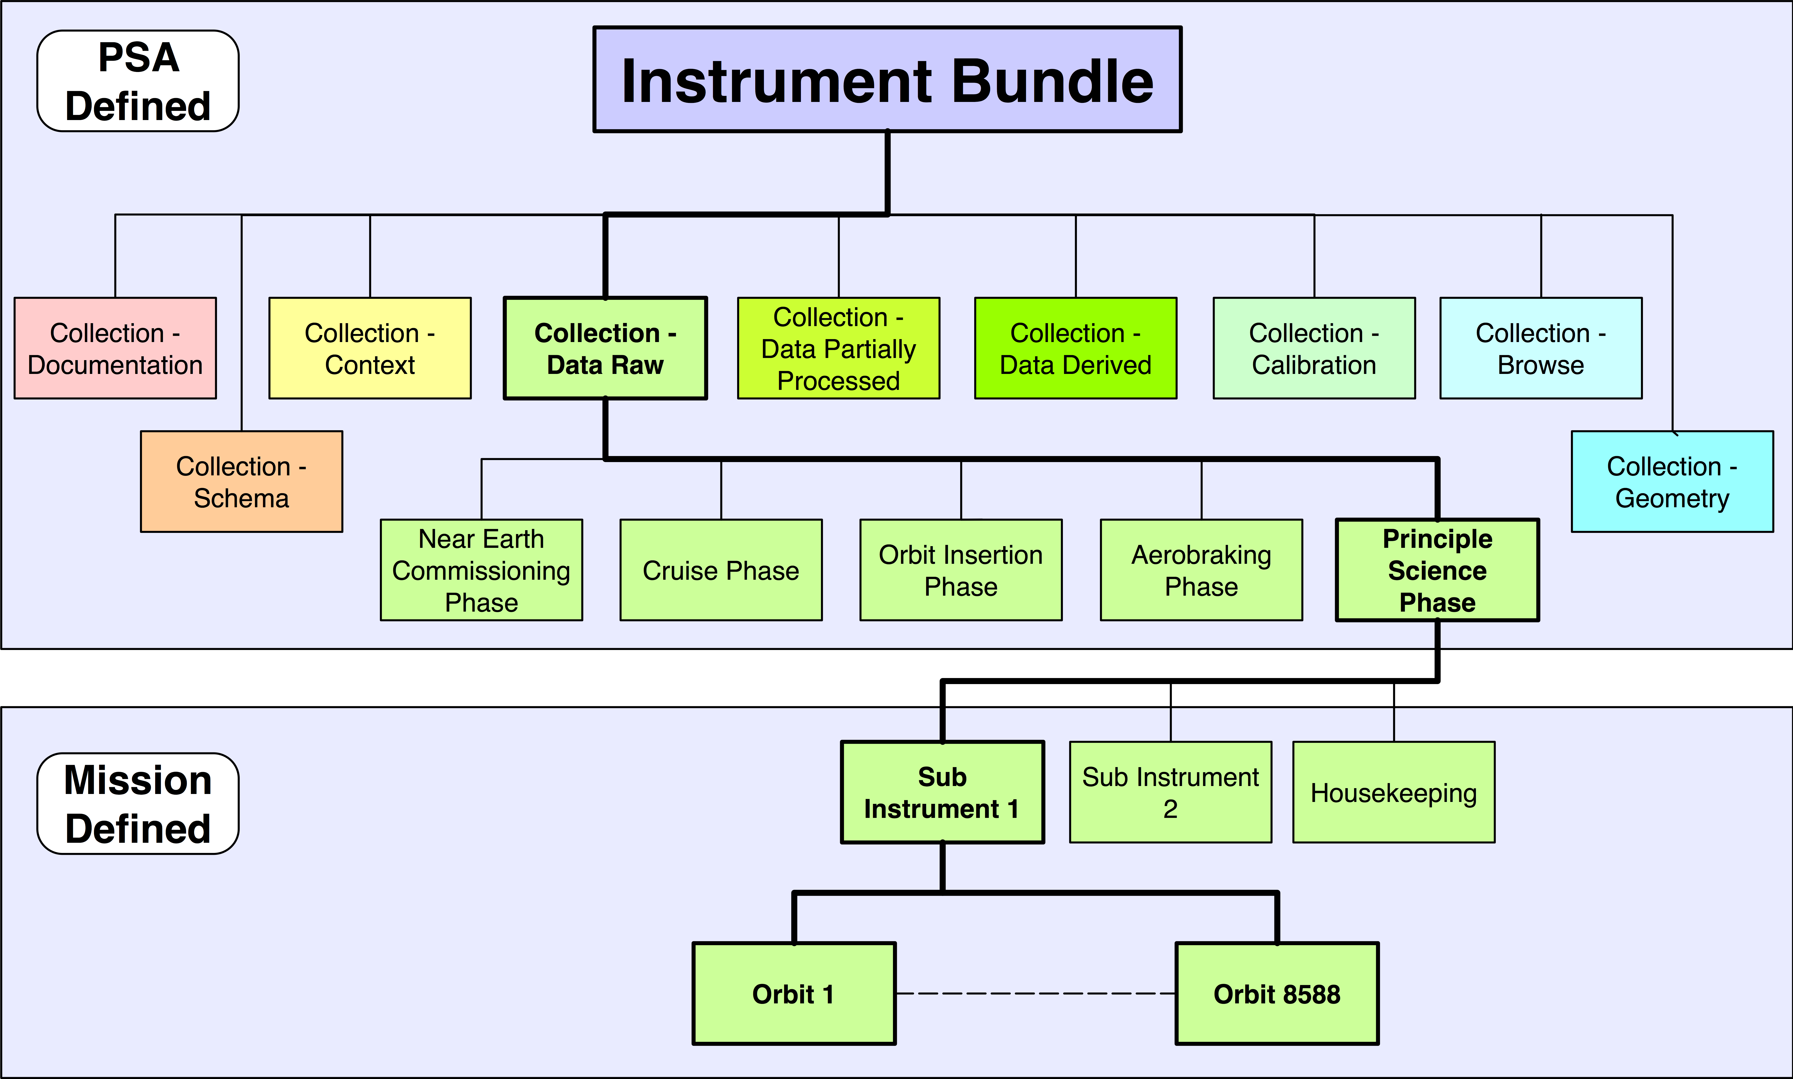
Instrument Bundle Physical Structure

Slide 19
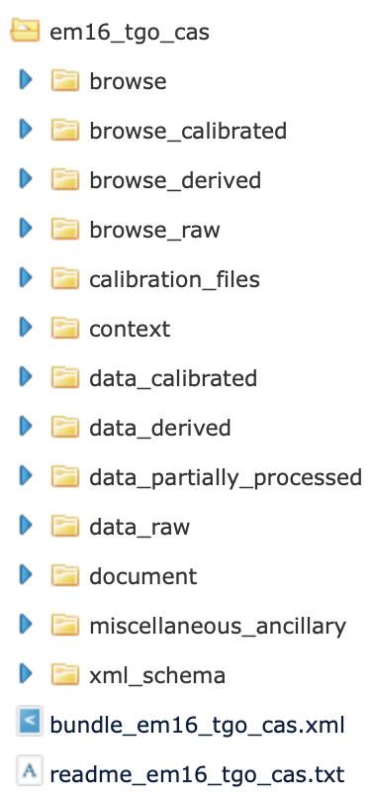
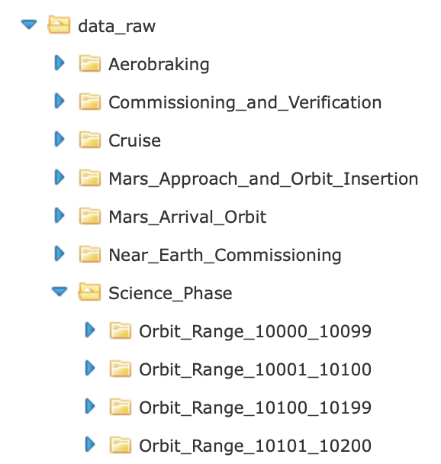
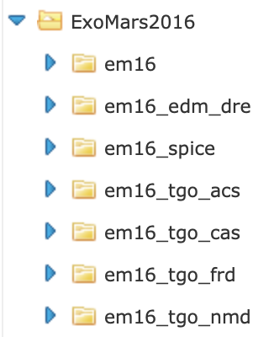
PSA Data Structures
Bundles forming the ExoMars archive, also top level directories
Layers of physical structure below the collection level
Bundle label file
Collections in CaSSIS bundle, also directories

Slide 20
PDS4 Viewer

Slide 21
PDS4 Viewer
https://sbnwiki.asteroiddata.org/PDS4_Viewer.html

Slide 22
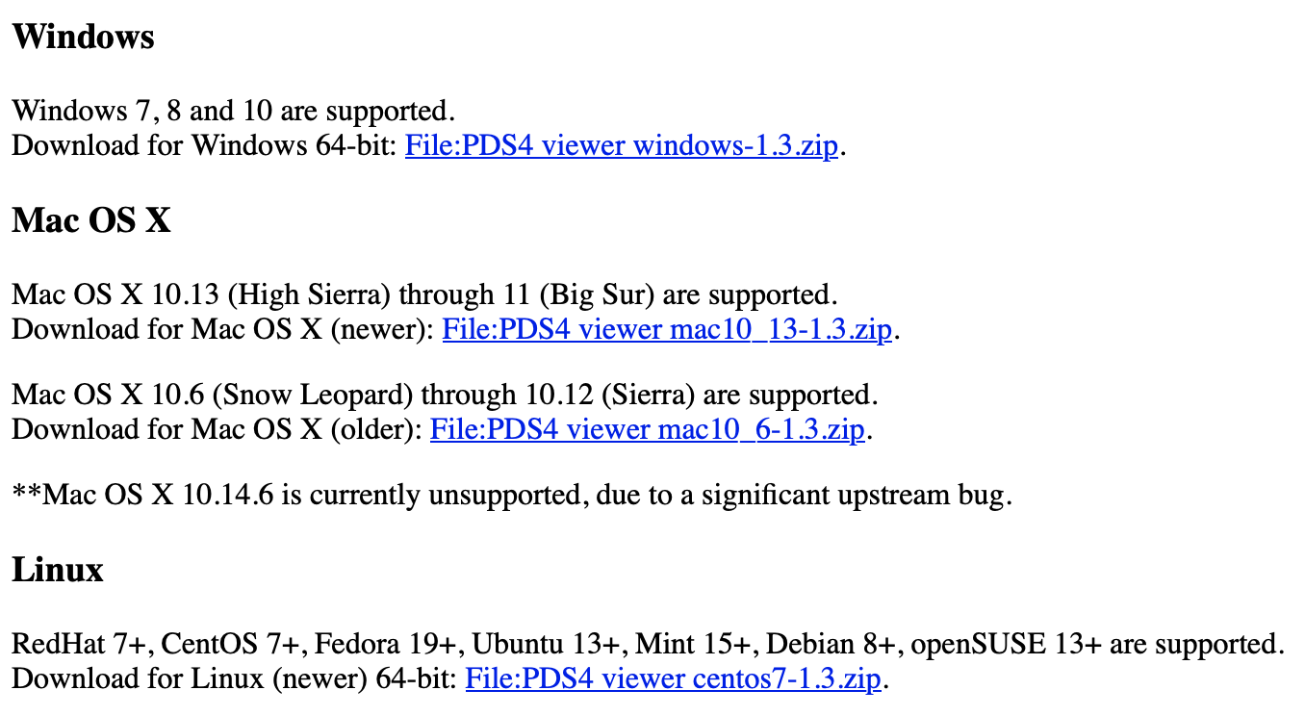
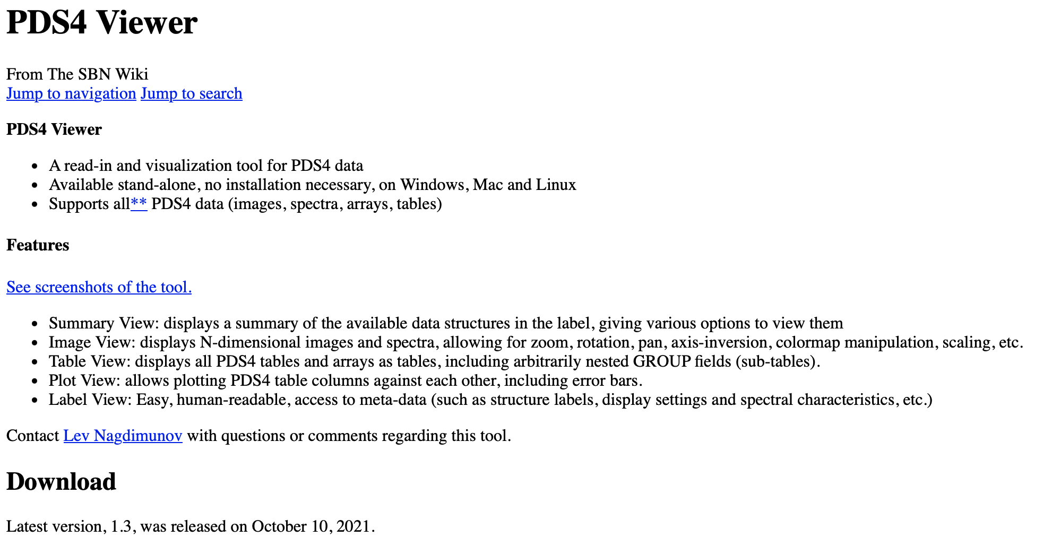

Slide 23
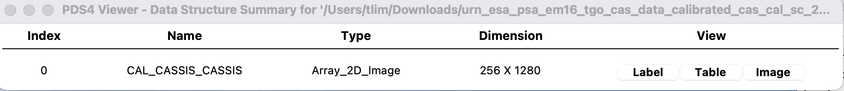
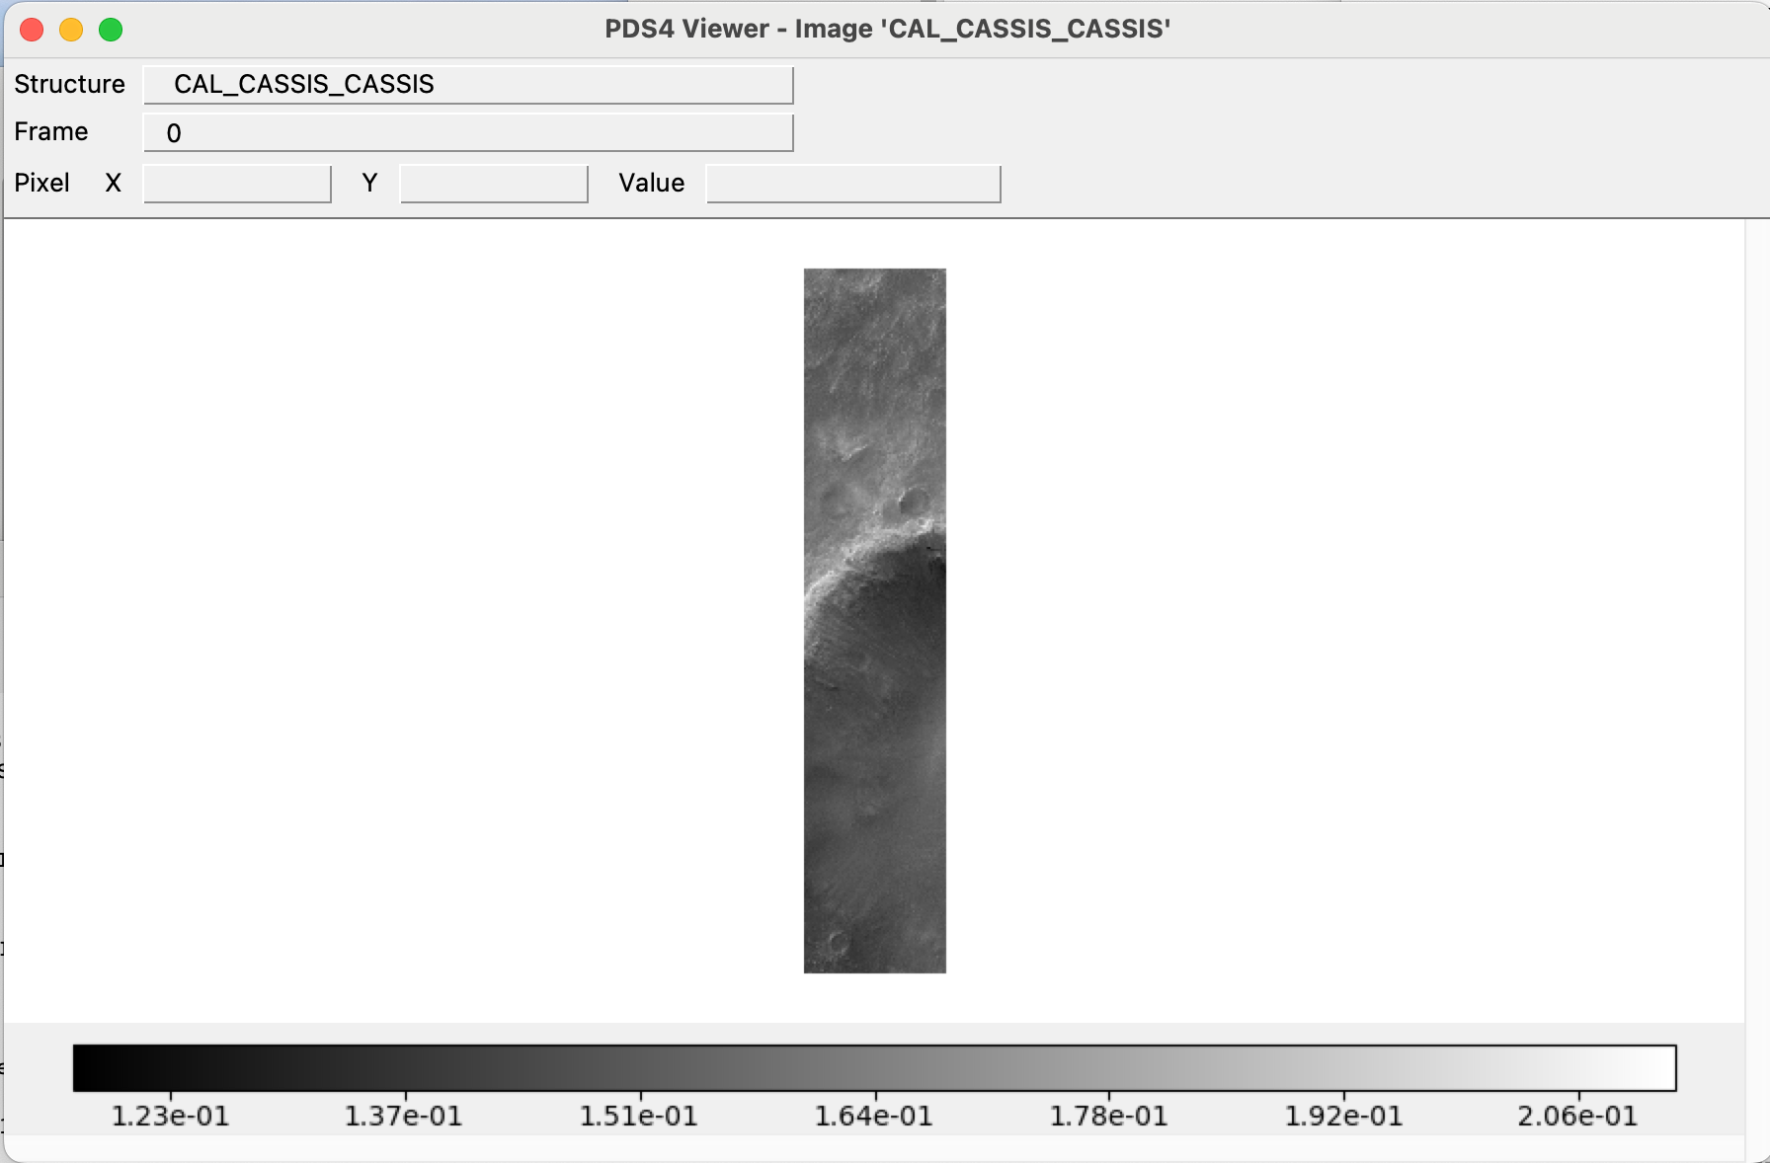
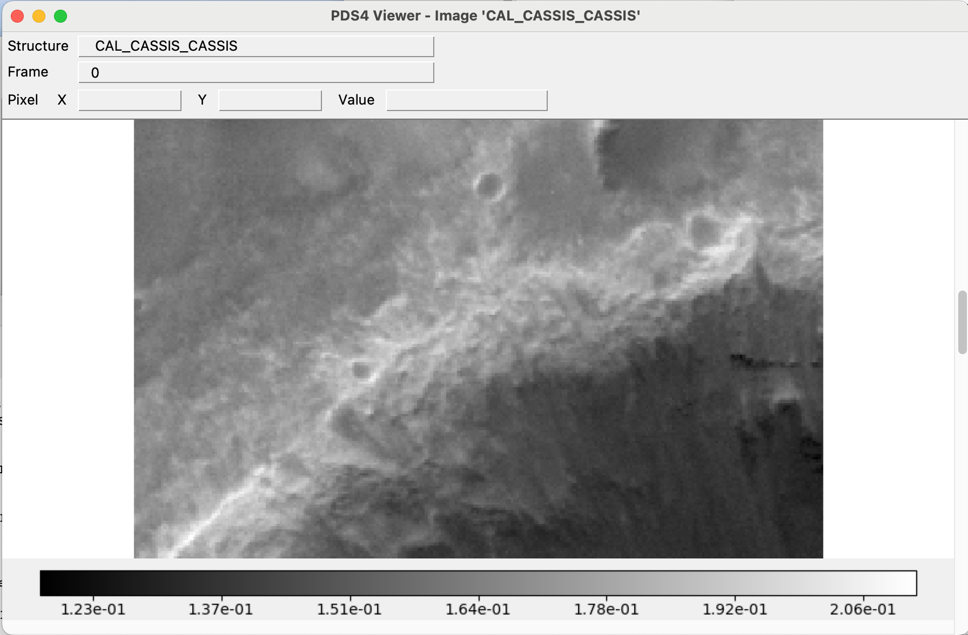

Slide 24
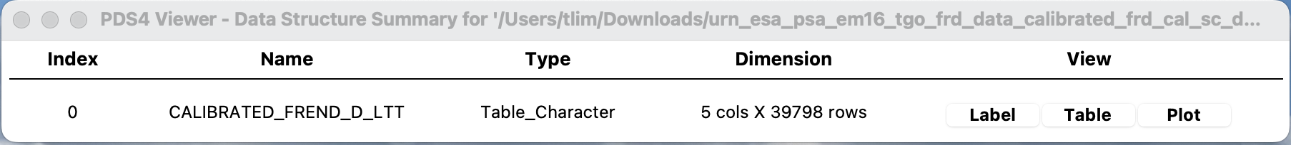
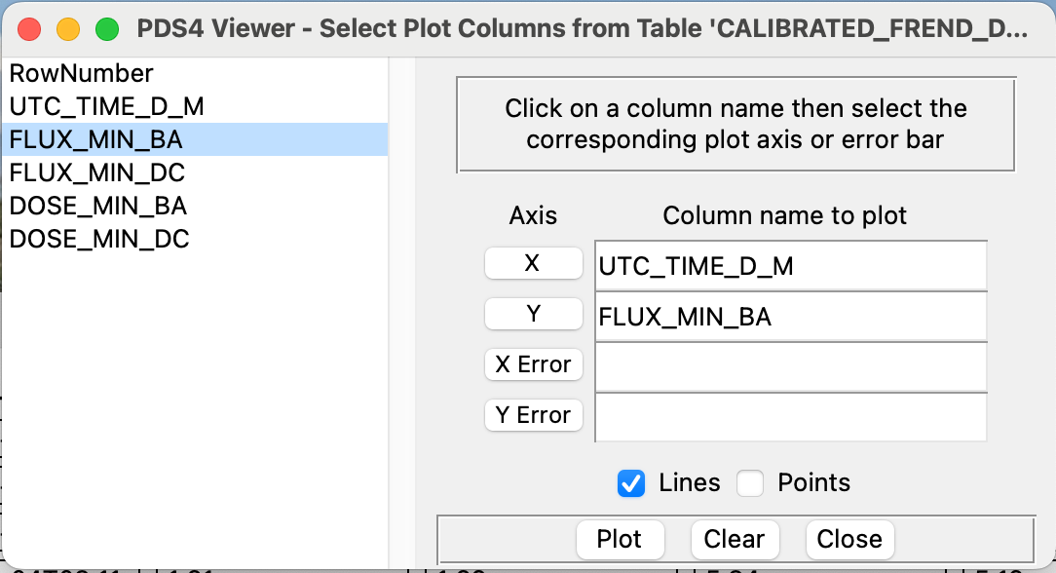
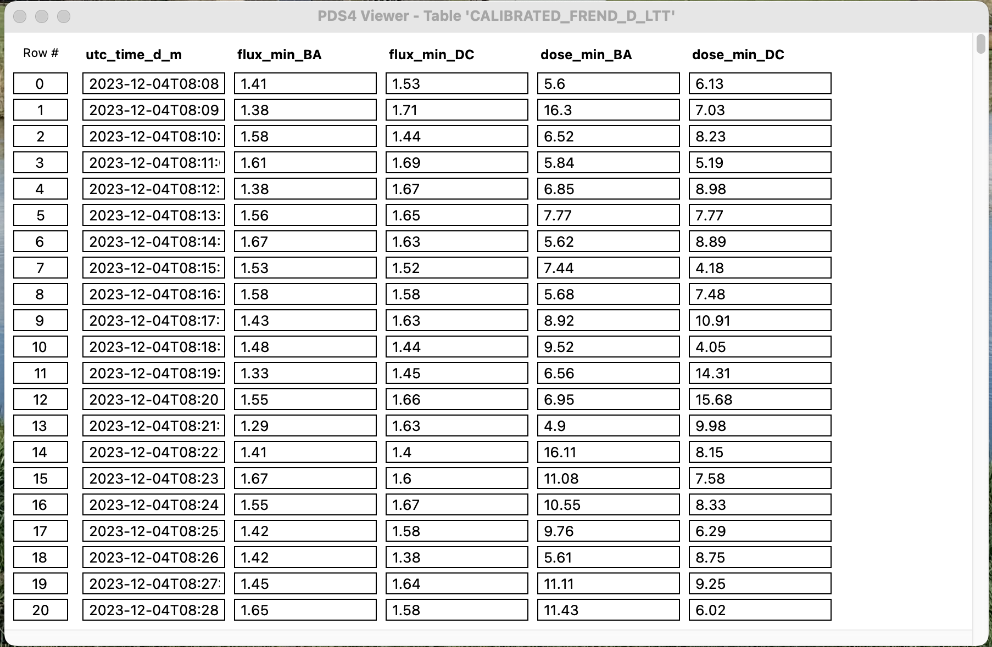
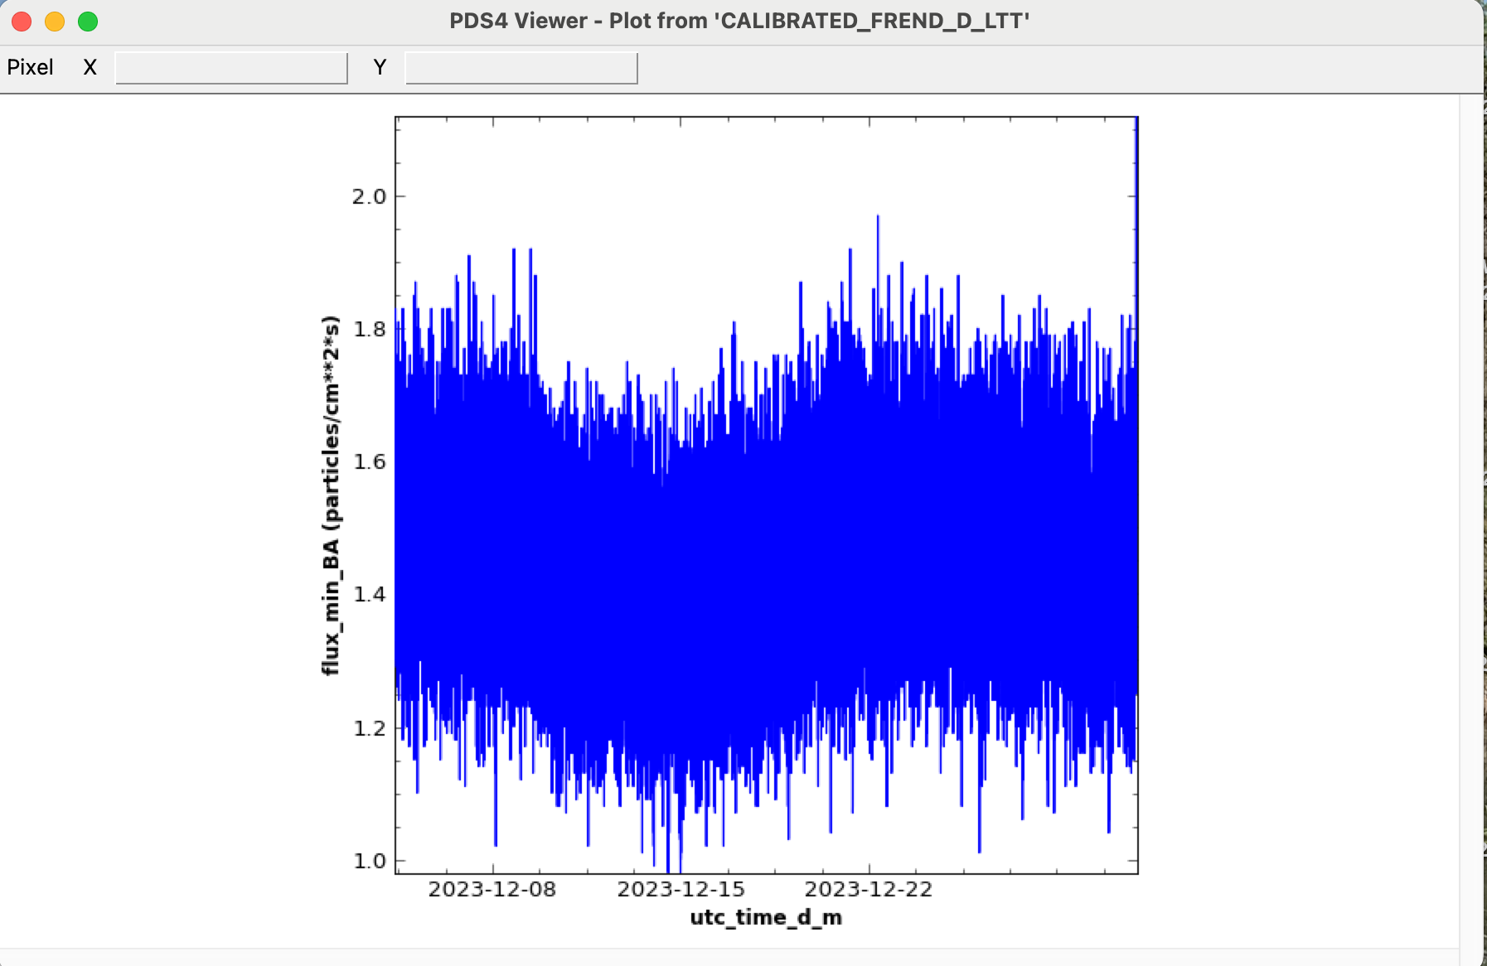

Slide 25
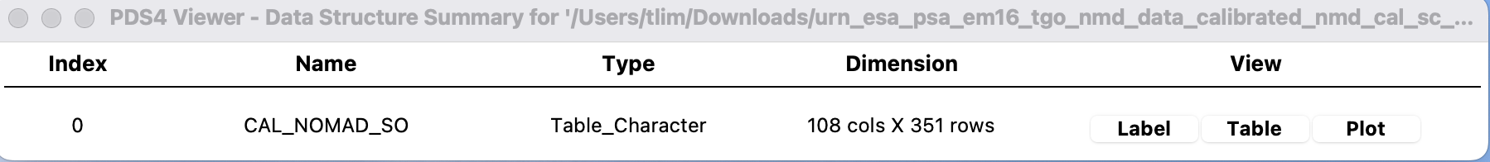
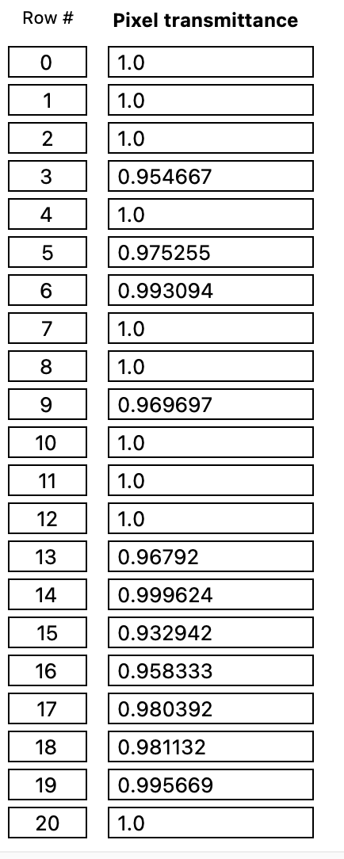
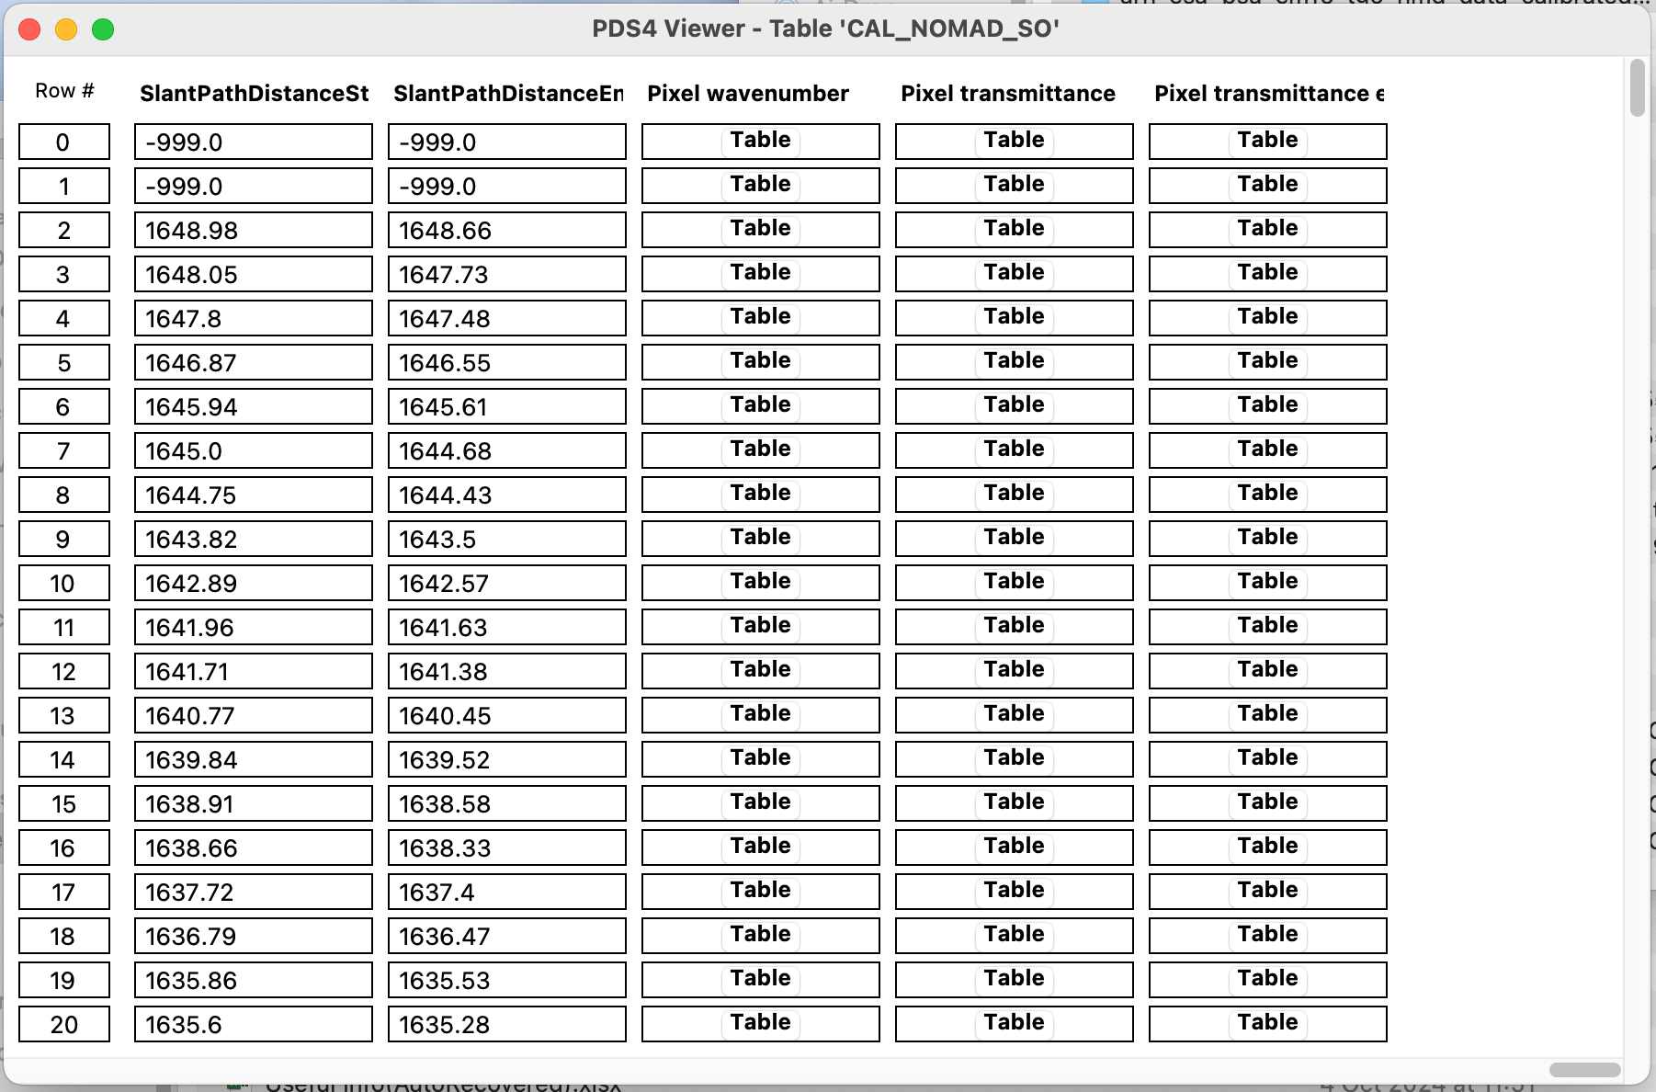
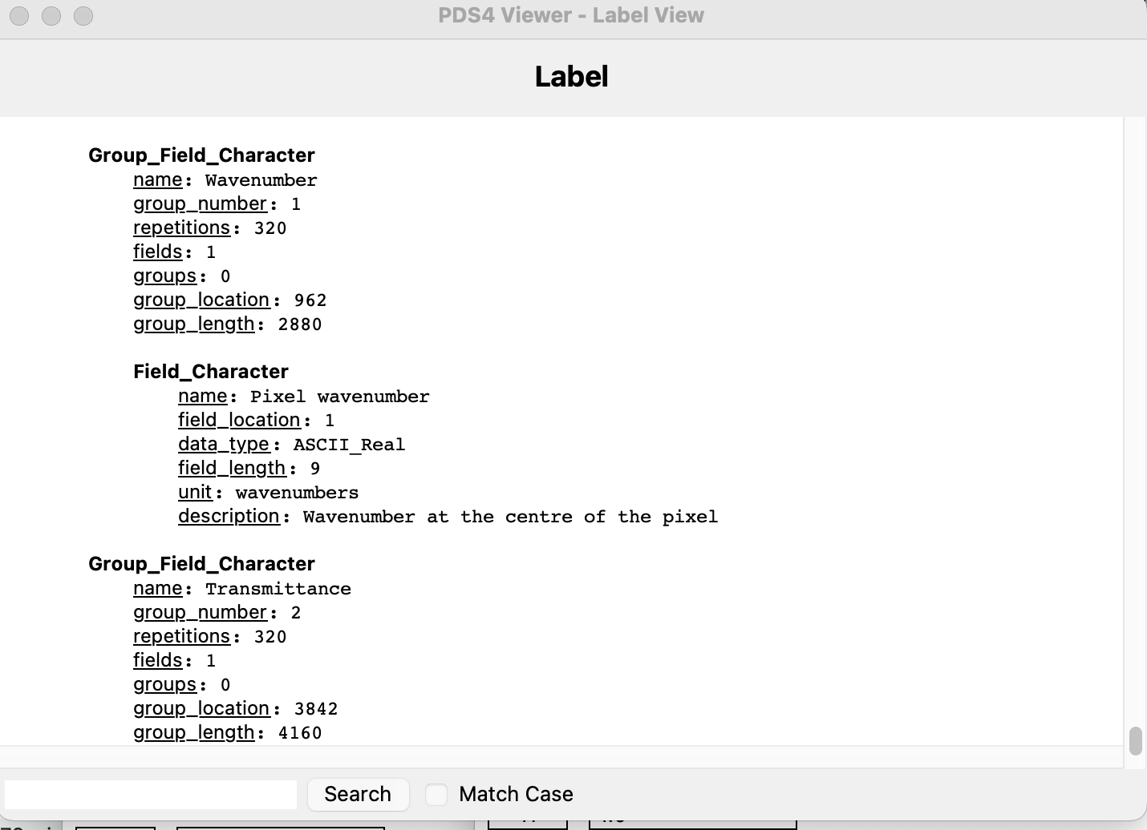

Slide 26
PSA Rules and Guidelines
4-8 November 2024, ESAC, Spain

Slide 27
Contents
A top-level introduction to dictionaries
What are dictionaries
What are the governance levels
What does the PSA do about dictionaries
The PSA dictionary
Documentation
The Archiving Guide
The Data User Guide (formerly known as the EAICD)
PSA rules mainly with a focus on bundle, collection and product naming

Slide 28
Dictionaries

Slide 29
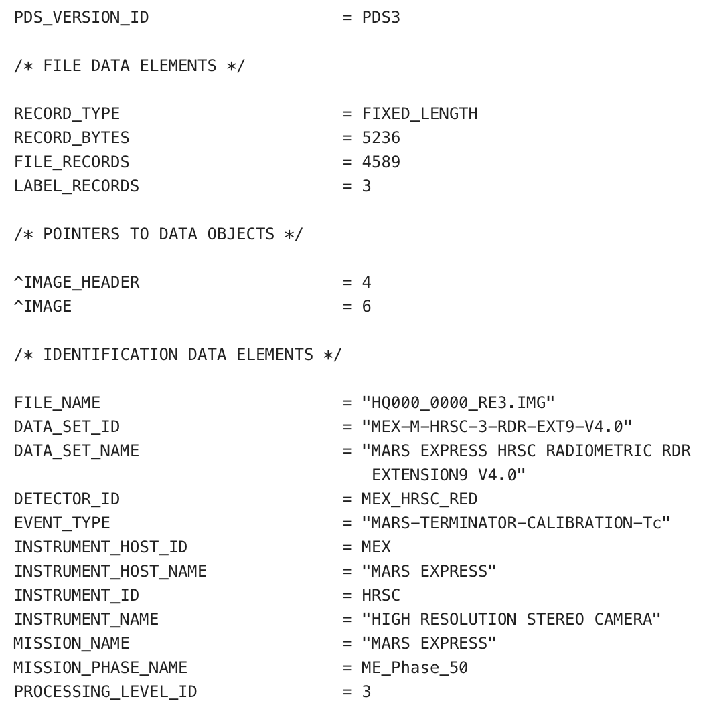
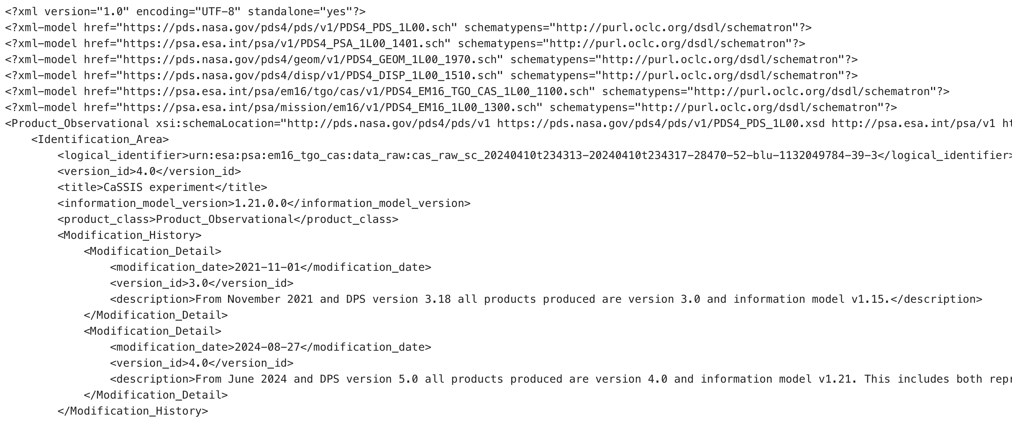
PDS3 and PDS4
On the left is the start of an older PDS3 label for a Mars Express HRSC image product
Below is the start of the PDS4 label for a ExoMars TGO CaSSIS image product
Only MEX is still in operations using the PDS3 standard
The long term plan is to migrate all data to PDS4

Slide 30
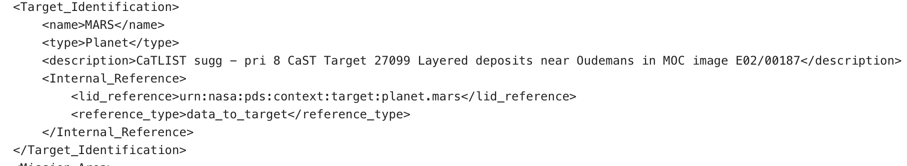
PDS4/XML Terminology
An XML element e.g. <name>MARS</name>
An attribute e.g. <em16_tgo_acs:delay unit="s">0</em16_tgo_acs:delay>
As shorthand both elements and attributes tend to be refered to as attributes
PDS4 attributes form groups known as classes
Elements/attributes are defined in dictionaries/schema
Associated rules are defined in schematron

Slide 31
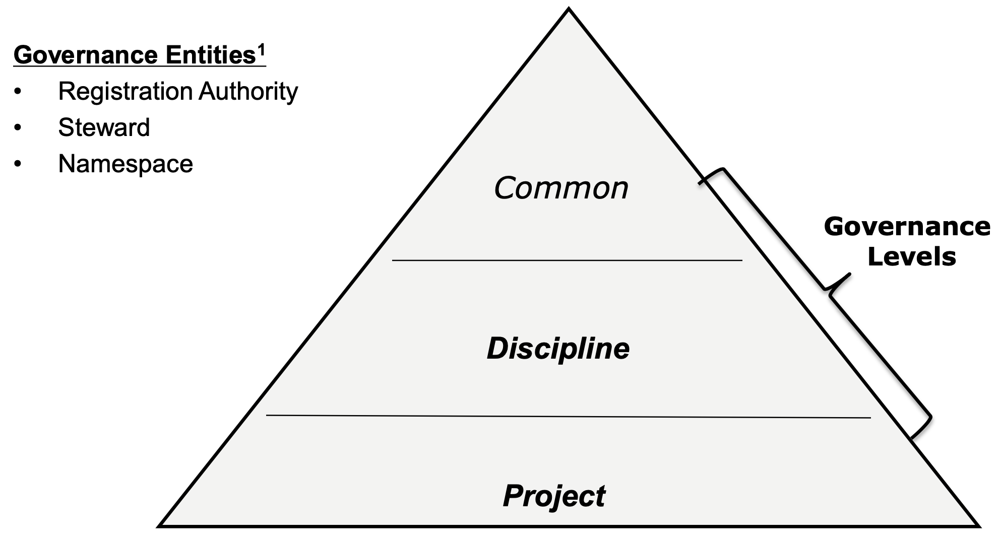
PDS4 Dictionaries
Used in every product

Slide 32
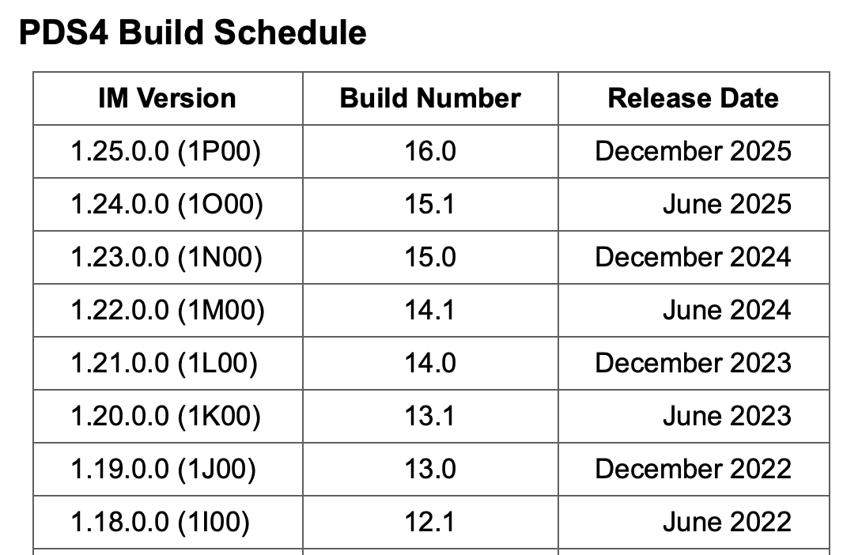
More PDS4/XML Terminology
Everything which goes into PDS, in particular the core dictionary and schematron is also known as the PDS4 Information Model (IM)
This model includes some other entities such as namespaces and context which we will come back to later…
A new version of the model is published every 6 months and this includes updates to both the core and dscipline dictionaries

Slide 33
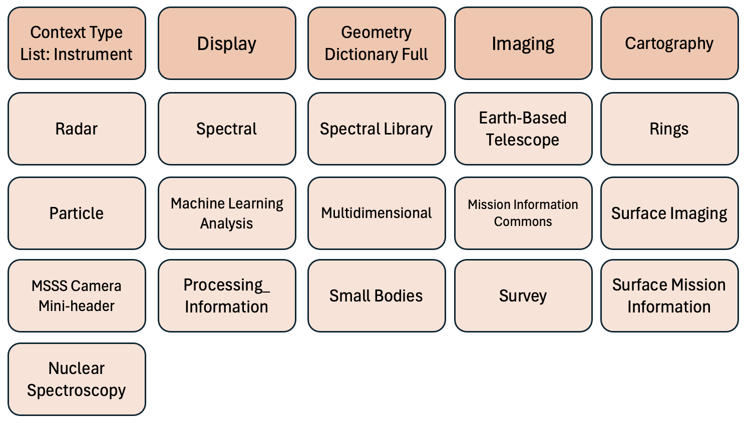
PDS4 Discipline Dictionaries

Slide 34
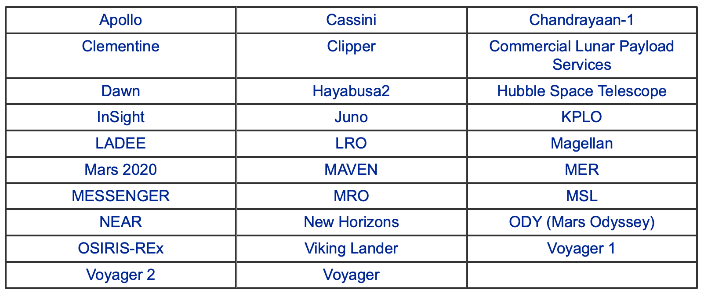
PDS Mission Dictionaries
These are rarely referenced outside the data for that particular mission

Slide 35
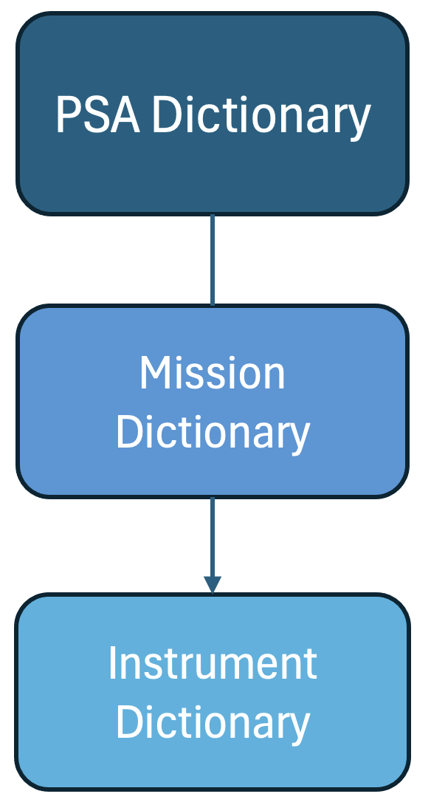
PSA Dictionaries
Takeaway:
Stuff is defined all over the place!
Not all discipline (or PDS mission) dictionaries are well documented, in fact the majority are not
But PDS do know this and are planning to improve
What is important to be familiar with is the core dictionary, the PSA dictionary and your mission/instrument dictionary
You can do all you need with just these, but your archive scientist can advise on using these and additionally using discipline dictionaries which we will recommend in most cases

Slide 36
Naming Conventions

Slide 37
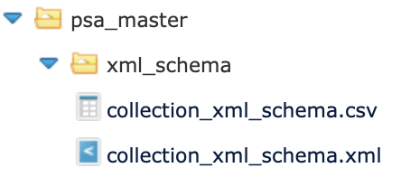
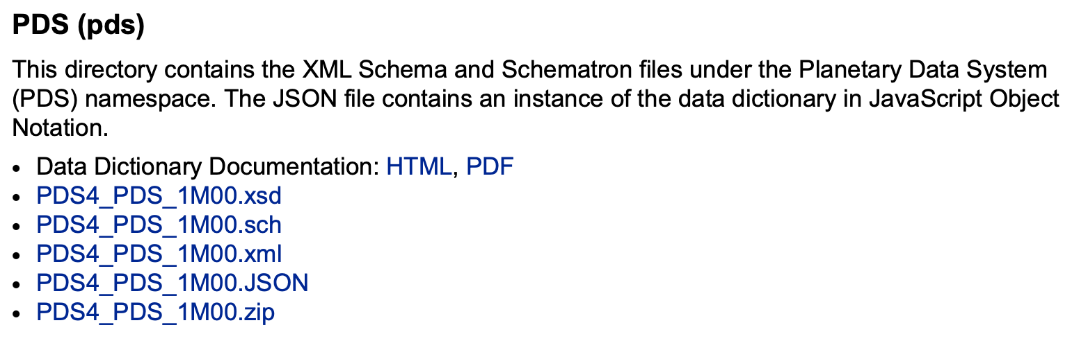
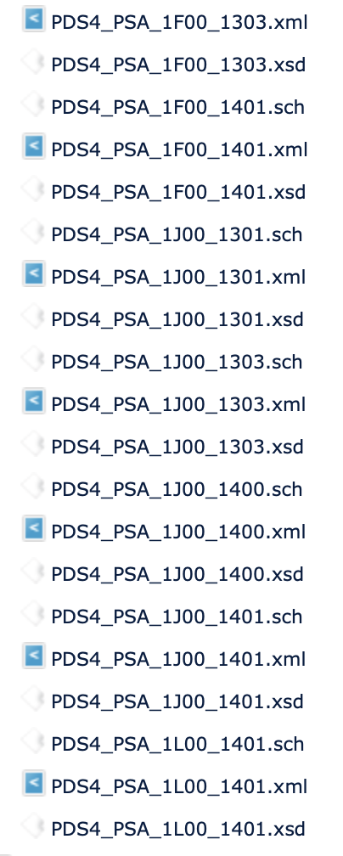
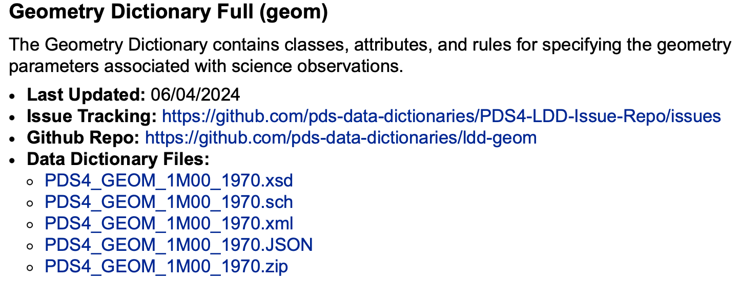
Dictionary Naming

Slide 38
Mission Dictionary Naming
Component | Namespace | URLs
Mission: ExoMars | http://psa.esa.int/psa/em16/v1 | PDS4_EM16_1L00_1300.xml PDS4_EM16_1L00_1300.xsd PDS4_EM16_1L00_1300.sch
Host: TGO | http://psa.esa.int/psa/em16/tgo/v1
Instrument: NOMAD | http://psa.esa.int/psa/em16/tgo/nmd | PDS4_EM16_TGO_NMD_1L00_1200.xml PDS4_EM16_TGO_NMD_1L00_1200.xsd PDS4_EM16_TGO_NMD_1L00_1200.sch
Namespace Registry:
https://s2e2.cosmos.esa.int/confluence/display/PSAPUB1/PSA+namespace+registry

Slide 39
PSA Naming
 | Bundle | Filenames
Bundle | em16 | No conventions set
Host: TGO | em16_tgo | No conventions set
Instrument: NOMAD Instrument: MCAM (Bepi) Instrument: RADEM (Juice) | em16_tgo_nmd bc_mtm_mcam juice_rad | nmd_raw_sc_uvis_....... cam_raw_sc_cam3_....... rad_raw_sc_.....
JUICE only has one host so only two acronyms needed for the bundle name
RADEM has no sub-instruments

Slide 40
The PSA Dictionary

Slide 41
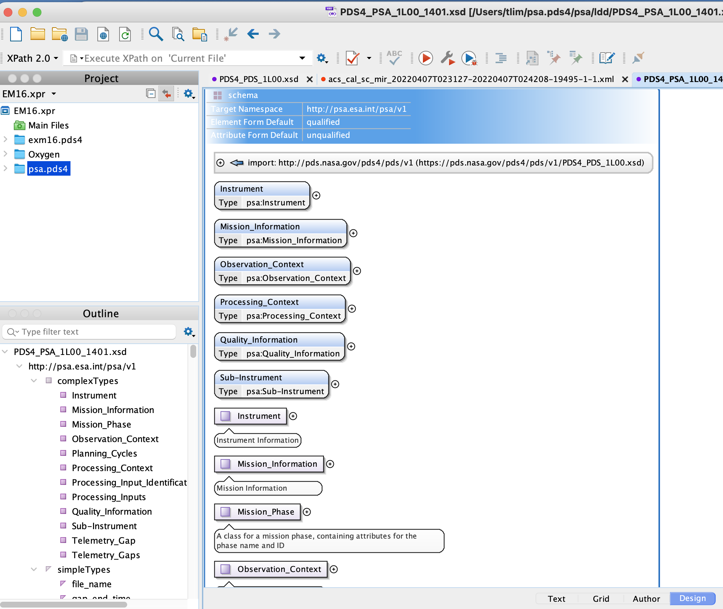
PSA Dictionary
This is a design view using the oxygen editor of PDS_PSA_1L00_1401
The first part of the dictionary defines the six main classes used in the dictionary.
Next are the subclasses, then the attributes are defined

Slide 42
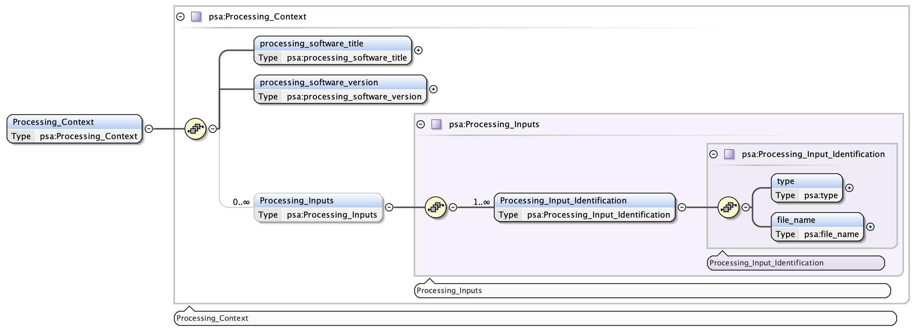
Classes Can Be Nested
By convention attributes are always lower case and classes have the first letter(s) as a capital

Slide 43
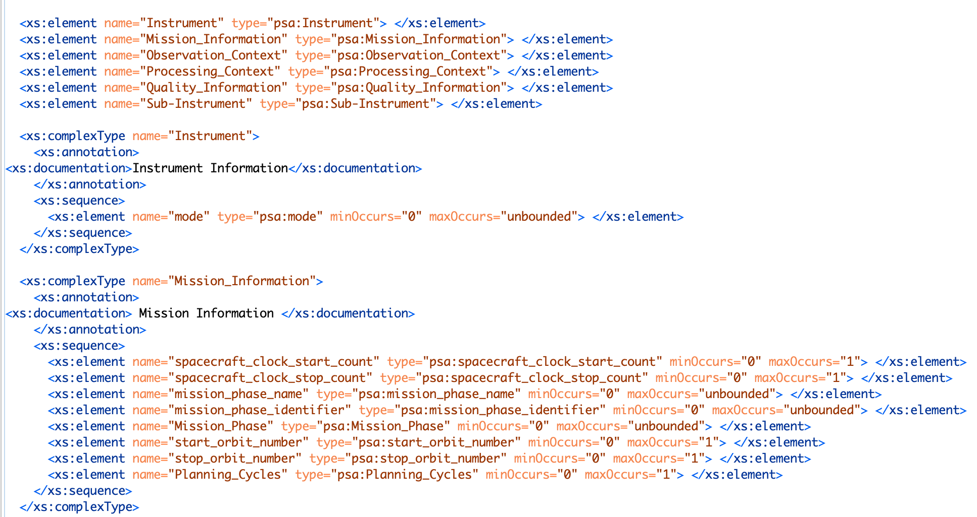
PSA Dictionary – Class List, Then First Two Classes

Slide 44
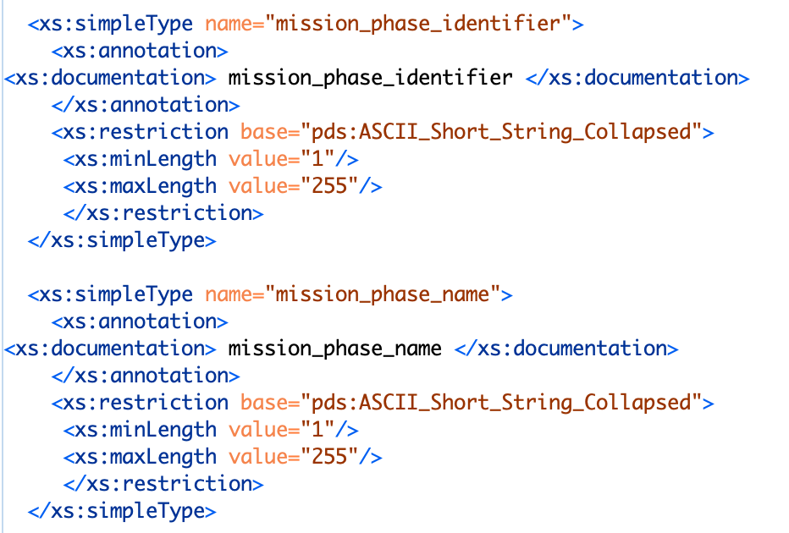
PSA Dictionary – Two attribute definitions
You will never be asked to write a dictionary!
Instead we run LDD_Tool on an easier to prepare input file.

Slide 45
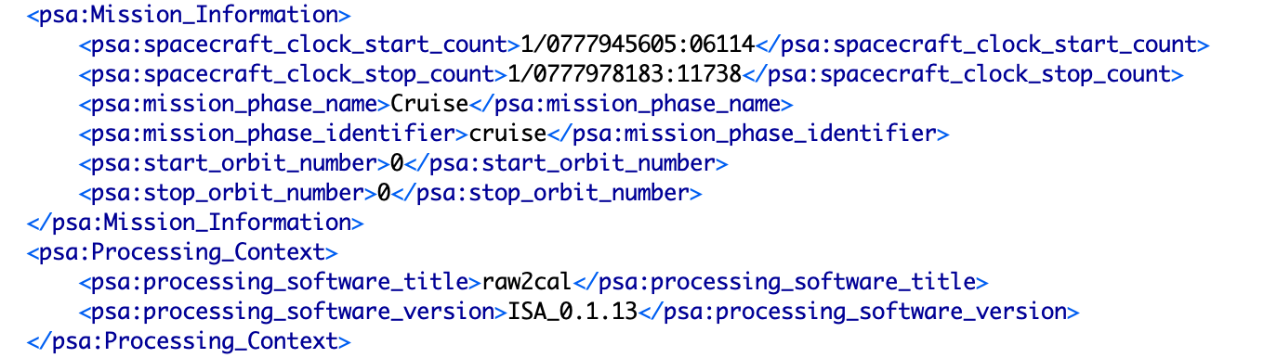
Using This In A Data File – Bepi ISA Instrument

Slide 46
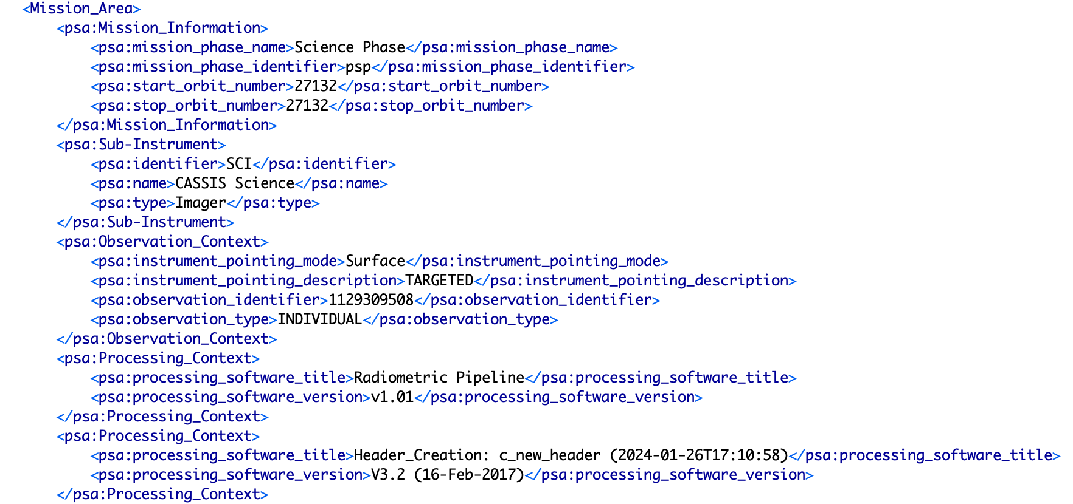
Using This In A Data File – TGO CaSSIS Instrument

Slide 47
Documentation

Slide 48
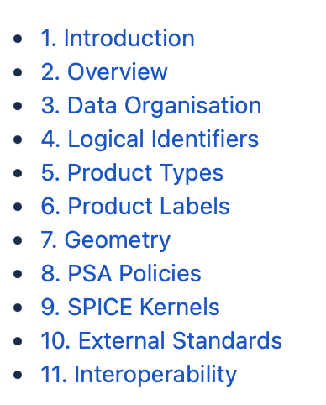
PSA Documents
The PSA Archiving Guide contains all the added rules and guidelines specific to the PSA
https://s2e2.cosmos.esa.int/confluence/display/PSAPUB1/PDS4+Archiving+Guide

